Slide 1
Microsoft SQL Server Basics

Slide 2
Prerequisite
SQL Server Instance Installed
SQL Server Management Studio Installed
** Please see my previous video for details.
Notes:
https://spark.apache.org/

Slide 3
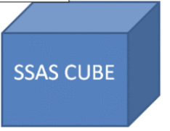

SQL Server Features, Instance, Version, Edition
OS - Linux/Windows
SQL Server Integration Service, Master Data Service
SQL Server Database Engine
SQL Server Analysis Service
SQL Server Reporting Service
DB1
DB1
Users
Logins
Users
Users

Slide 4
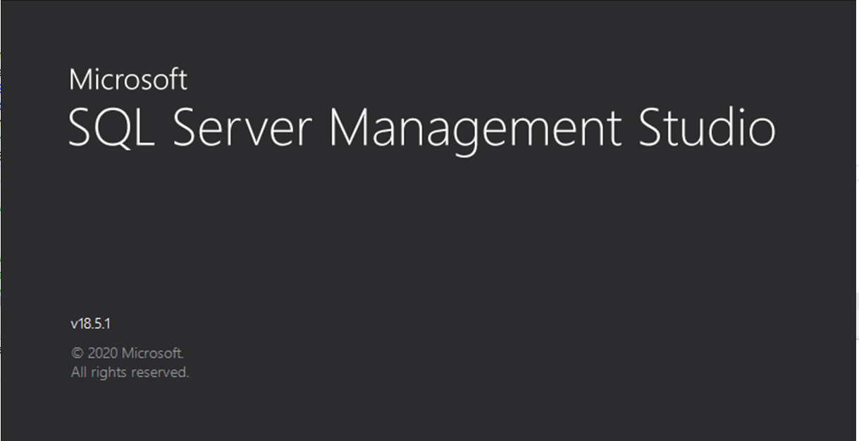

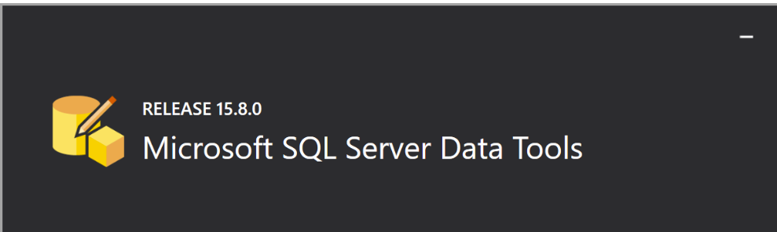
Tools
SQL Server Management Studio
Azure Data Studio
SQL Server Data Tool

Slide 5
SQL Server basics
Create login Create database Create user Grant permission Create table Create view Create functions Create procedure DSL & DML

Slide 6
Thanks for watching!
Please leave a comment if you have any questions!
If you like this video, please hit the below LIKE button and Subscribe it..

